Slide 1




Department of Electronics and Communication Engineering, NIT Silchar
Comprehensive Seminar
2nd Sem
Under the Supervision
Dr. Prabina Pattanayak
Asst. Professor
Dept. of ECE, NIT Silchar
Kirti Swagat Mohanty
Scholar Id:21304068
kirti21_rs@ece.nits.ac.in

Slide 2
Doctoral Committee (DC)
Department of Electronics and Communication Engineering, NIT Silchar
Dr. Ashraf Hossain, ECE, Chairman of DC
Dr. C Choudhury, ECE, Member of DC
Dr. C Bhattacharja, EE, Member of DC, (nominee of Chairman, Senate)
Dr. Prabina Pattanayak, ECE, Supervisor and Member DC
Kirti Swagat Mohanty
Scholar Id:21304068
kirti21_rs@ece.nits.ac.in

Slide 3
Outline
Department of Electronics and Communication Engineering, NIT Silchar
Course Work Details
Research Methodology
Information Theory and Coding
Image Processing
Broad Area of Research
Relevance of Course Work with Area of Research
Conclusion
Kirti Swagat Mohanty
Scholar Id:21304068
kirti21_rs@ece.nits.ac.in

Slide 4
Course Work Details
Department of Electronics and Communication Engineering, NIT Silchar
Sl. No | Subject Code | Subject | Faculty | Credit | Grades Obtained
1 | IC001 | Research Methodology | Dr. T. R Lenka Dr. B.K. Roy Dr. S Verma Dr. G Das Dr. N Sinha | 4
2 | EC-5135 | Information Theory and Coding | Dr. P Pattanayk Dr. W Arif | 3
3 | EC-5141 | Image Processing | Dr. R.K Karsh | 3
Kirti Swagat Mohanty
Scholar Id:21304068
kirti21_rs@ece.nits.ac.in

Slide 5
Research Methodology (IC001)
Department of Electronics and Communication Engineering, NIT Silchar
Course Instructors
Dr. Trupti Ranjan Lenka, Dept. of ECE
Dr. Binoy Krishna Roy, Dept. of EE
Dr. Nidul Sinha, Dept. of EE
Dr. Gurudas Das, Dept. of Humanities and Social Science
Dr. Saurabh Verma, Dept. of Management Studies
Kirti Swagat Mohanty
Scholar Id:21304068
kirti21_rs@ece.nits.ac.in

Slide 6
Outline
Department of Electronics and Communication Engineering, NIT Silchar
Research
Creativity, Communication and Management
Style and Format of Report Writing
Experimentation
Interpretation of Data
Intellectual Property Rights
Kirti Swagat Mohanty
Scholar Id:21304068
kirti21_rs@ece.nits.ac.in

Slide 7
Research
Department of Electronics and Communication Engineering, NIT Silchar
Definition
Applications
Characteristics and Requirements
Research Process
Kirti Swagat Mohanty
Scholar Id:21304068
kirti21_rs@ece.nits.ac.in

Slide 8
Definition
Department of Electronics and Communication Engineering, NIT Silchar
It’s the process of finding solutions to a problem after a thorough study and analysis of situational factors.
It provides the needed information that guides decision makers to successfully deal with the problems.
Kirti Swagat Mohanty
Scholar Id:21304068
kirti21_rs@ece.nits.ac.in

Slide 9
Applications of Research
Department of Electronics and Communication Engineering, NIT Silchar
Pure Research
It’s aim is not to find the solutions for the current problems but to think for the wider areas of life.
It doesn’t provide any benefits to the masses at the time it is done but in the future the results can be applied to gain the benefits.
The purpose of this is to gain greater knowledge of the world, develop new theories.
These types of researches don’t work under any pre-defined time boundaries.
Kirti Swagat Mohanty
Scholar Id:21304068
kirti21_rs@ece.nits.ac.in

Slide 10
Applications of Research
Department of Electronics and Communication Engineering, NIT Silchar
Applied Research
It’s done to get the answers for the current problems.
It can be done to verify previously done research.
The outcomes of these researches give benefit to the real world.
In these type of researches there is a time-frame.
The tools, techniques and procedures that are discovered in Pure Research are used to find solutions in Applied Research.
Kirti Swagat Mohanty
Scholar Id:21304068
kirti21_rs@ece.nits.ac.in

Slide 11
Characteristics of Research
Department of Electronics and Communication Engineering, NIT Silchar
Action-Oriented
Cost-effective
Generative
Logical
Reductive
Replicable
Participatory
Simple and Time- Bound
Systematic
Kirti Swagat Mohanty
Scholar Id:21304068
kirti21_rs@ece.nits.ac.in
Notes:
. The research should be action-oriented. In other words, it should be aimed at reaching a solution leading to the implementation of its findings.
. The research must be as much cost-effective as possible.
. The research should be generative. This is one of the valuable characteristics of research because answering one question leads to generating many other new questions.
. The research should be logical. Without manipulating ideas logically, the scientific researcher cannot make much progress in any investigation.
. The research should be reductive. This means that the findings of one researcher should be made available to other researchers to prevent them from repeating the same research.
. The research should be replicable. This asserts that there should be scope to confirm the findings of previous research in a new environment and different settings with a new group of subjects or at a different point in time.
. The research should be participatory, involving all parties concerned (from policymakers down to community members) at all stages of the study.
. The research must be relatively simple, timely, and time-bound, employing a comparatively simple design.
. The research should be systematic. It emphasizes that a researcher should employ a structured procedure.
. The results of the research should be presented in formats most useful for administrators, decision-makers, business managers, or the community members.

Slide 12
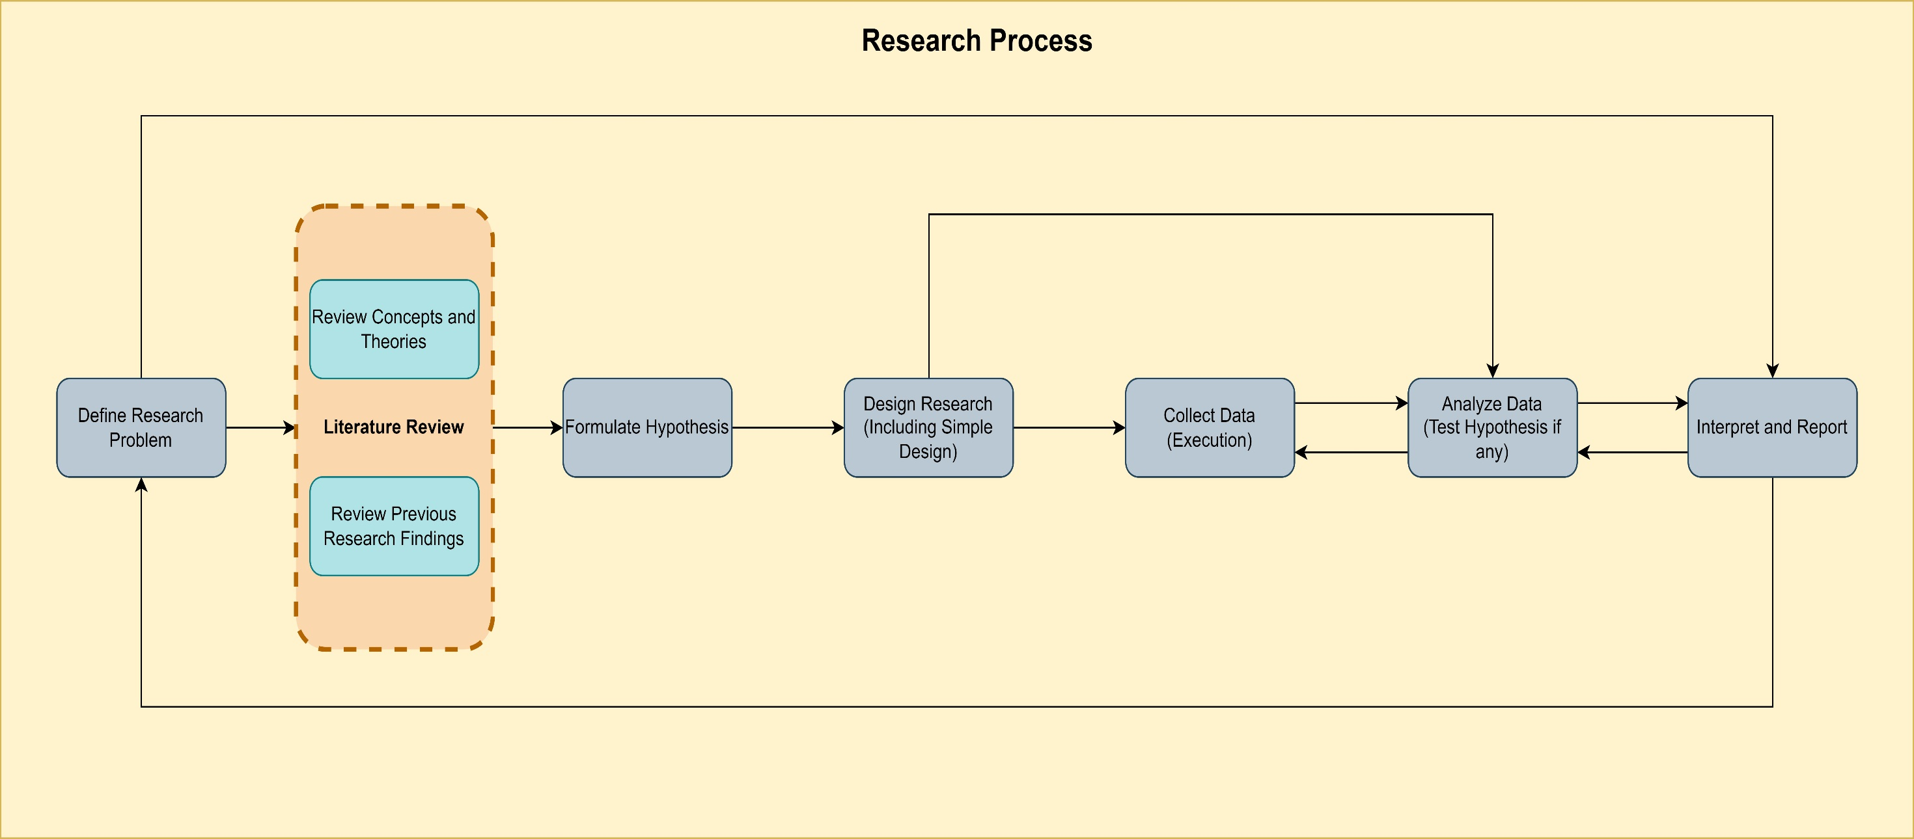
Research Process
Department of Electronics and Communication Engineering, NIT Silchar
Kirti Swagat Mohanty
Scholar Id:21304068
kirti21_rs@ece.nits.ac.in
Notes:
Step-1 : Identify and defining the Research Problem
The first step in the process is to identify a problem or develop a research question.
The research problem comes up with the ongoing phenomenon or issues.
A research problem is a statement about an area of concern, a condition to be improved, a difficulty to be eliminated, or a troubling question that exists in scholarly literature, in theory, or in practice that points to the need for meaningful understanding and deliberate investigation.
A research problem does not state how to do something, offer a vague or broad proposition, or present a value question.
Step 2: Review the Literature
The researcher must learn more about the topic under investigation. To do this, the researcher must review the literature related to the research problem. This step provides foundational knowledge about the problem area.
It helps the researchers about what studies have been conducted in the past, how these studies were conducted and the conclusions in the problem area.
Step 3: Formulating a Hypothesis
In this step, the researcher makes the problem precise.
. The research work is topic focused and refined.
Then the researcher steps forward to how the problem would be approached? The nature of the research problem can decide to formulate a definite hypothesis.
. A hypothesis is tested. Effective research work formulates a hypothesis in such a way that collected factual data will provide evidence that either supports or disproves them. Formulation of Hypothesis in Research will make you more expert.
. In the end, the hypothesis turns into a practical theory
In order to develop working hypotheses researcher should adopt the following approach
Discussions with colleagues and experts about the problem, its origin and the objectives in seeking a solution;
Examination of data and records, if available, concerning the problem for possible trends, peculiarities and other clues;
Review of similar studies in the area or of the studies on similar problems; and
Exploratory personal investigation which involves original field interviews on a limited scale with interested parties and individuals with a view to secure greater insight into the practical aspects of the problem.
Step 4: Research Design
. Research design decides how the research materials will be collected. One or more research methods, for example, experiment, survey, interview, etc are chosen depending on the research objectives.
. The function of research design is to provide for the collection of relevant evidence with minimal expenditure of effort, time and money. But how all these can be achieved depends mainly on the research purpose.
. Research purposes may be grouped into four categories, a. Exploration, b. Description, c. Diagnosis, and d. Experimentation.
Step 5: Carry out the Research Process
While the research design is decided, then the researcher collects data, records information.
The researcher proceeds with the research. Practical difficulties may arise in this stage.
For example, the research method may not suit properly. The interviewer might be unwilling to let carry out the research as planned.
Moreover, a false interpretation could potentially bias the result of the study.
So, when you collect data, you need to know the effective techniques of data collection in order to gather necessary and relevant information with regard to research.
Step 6: Preparing Research Results
Now work out the implications of the data you gathered.
Your challenges are not over yet. Rather problems might just begin!
It is hardly easy to clear out the implications of the gathered materials. While it is possible to clarify the research questions, some investigations are less conclusive.
So, interpret your research results in order to report the findings.
No matter what kind of research you are doing, there comes a moment when your head is full of ideas that originated from your analysis.
Ideally, you’ll write them down as they come to you. Now you need to convert the mass of those elements and ideas into a written text that makes sense to the reader and can do justice to your quest
Step 7: Reporting Research Findings
The final step of the research process outline is to report the research findings.
Describe the significance of the research study.
Work out how do they relate to the previous research findings.
Usually, the research report published as a journal article or book.
This is the last stage in terms of the individual research project. Mostly, a research report discusses questions that remained unanswered & suggest further research in the future in general.

Slide 13
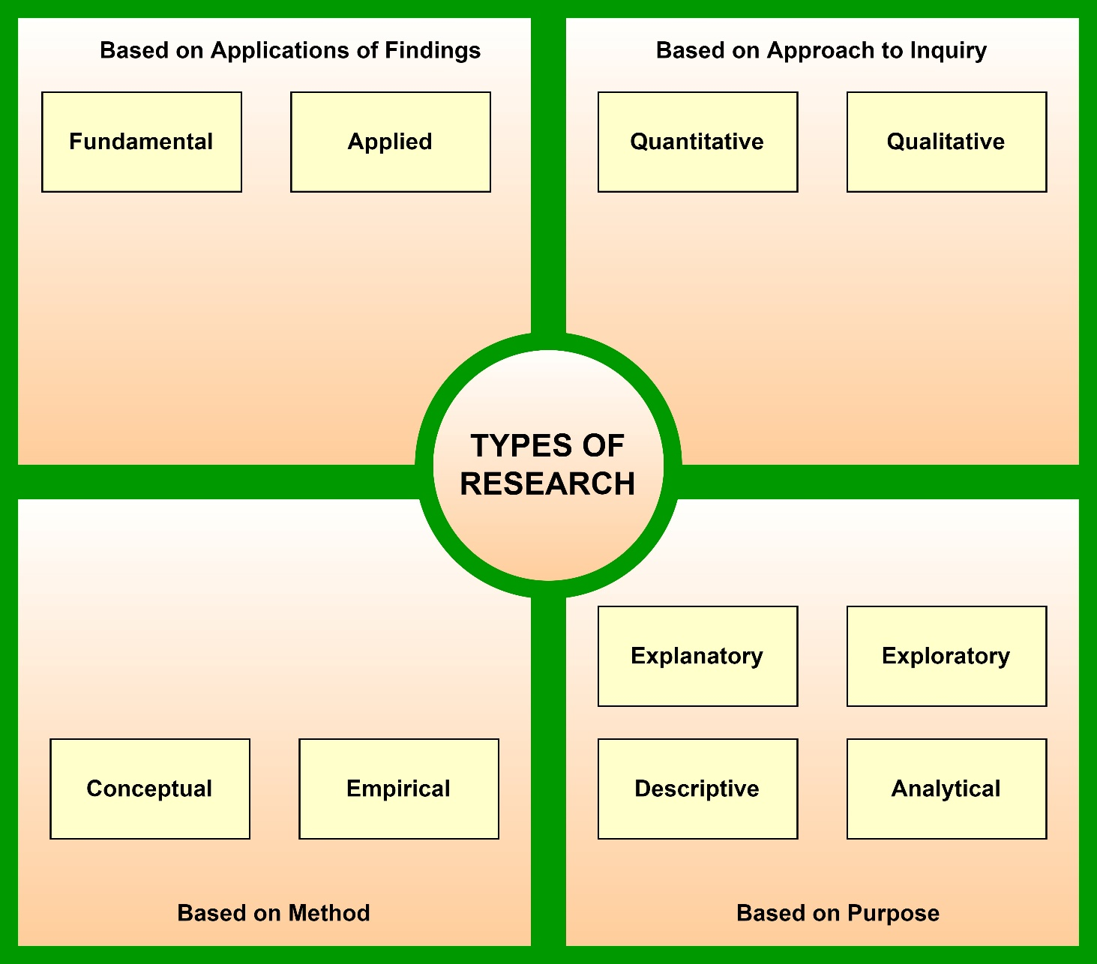
Types of Research
Department of Electronics and Communication Engineering, NIT Silchar
Kirti Swagat Mohanty
Scholar Id:21304068
kirti21_rs@ece.nits.ac.in

Slide 14
Fundamental Research
Department of Electronics and Communication Engineering, NIT Silchar
It is an investigation on basic principles and reasons for occurrence of a particular event.
It is also known as Basic Research.
Basic Researches sometimes may not lead to immediate use or applications. It is not concerned with solving any practical problems.
The outcomes of basic research form the basis for many applied research.
Kirti Swagat Mohanty
Scholar Id:21304068
kirti21_rs@ece.nits.ac.in

Slide 15
Examples of Fundamental Research
Department of Electronics and Communication Engineering, NIT Silchar
A critical analysis of product placement as an effective marketing strategy.
An investigation into the main elements of brands and branding
A study of factors impacting each stage of product life cycle.
Kirti Swagat Mohanty
Scholar Id:21304068
kirti21_rs@ece.nits.ac.in

Slide 16
Advantages of Fundamental Research
Department of Electronics and Communication Engineering, NIT Silchar
It is important to expand the pool of knowledge in any discipline.
Findings of fundamental studies are usually applicable in a wide range of cases and scenarios.
It don’t have strict deadlines and they are usually driven by the curiosity of the researchers.
Kirti Swagat Mohanty
Scholar Id:21304068
kirti21_rs@ece.nits.ac.in

Slide 17
Disadvantages of Fundamental Research
Department of Electronics and Communication Engineering, NIT Silchar
Findings of this type of studies have little or no practical implications.
Fundamental Studies do not resolve concrete and specific business problems.
Kirti Swagat Mohanty
Scholar Id:21304068
kirti21_rs@ece.nits.ac.in

Slide 18
Applied Research
Department of Electronics and Communication Engineering, NIT Silchar
It is a type of research design that seeks to solve a specific problem or provide innovative solutions to issue affecting an individual, group or society.
It is often referred to as a scientific method of inquiry or contractual research because it involves the practical application of scientific methods to everyday problems.
When conducting applied research, the researcher takes extra care to identify a problem, develop a research hypothesis and goes ahead to test these hypothesis via an experiment.
Kirti Swagat Mohanty
Scholar Id:21304068
kirti21_rs@ece.nits.ac.in

Slide 19
Examples of Applied Research
Department of Electronics and Communication Engineering, NIT Silchar
To improve an organization’s hiring process.
To improve workplace efficiency and organizational policies.
To bridge skill gaps in the workplace.
To improve agricultural crop production.
To treat or cure a specific disease.
To identify the side effects of using a particular drug.
Kirti Swagat Mohanty
Scholar Id:21304068
kirti21_rs@ece.nits.ac.in

Slide 20
Advantages of Applied Research
Department of Electronics and Communication Engineering, NIT Silchar
Validity: Applied Research is unbiased in nature because it tests empirical evidence in order to arrive at valid research outcomes. It employs carefully mapped-out procedures, and this makes it a more valid research approach.
It is useful in solving specific problems.
It helps individuals and organizations to find solutions to specific problems.
Kirti Swagat Mohanty
Scholar Id:21304068
kirti21_rs@ece.nits.ac.in

Slide 21
Disadvantages of Applied Research
Department of Electronics and Communication Engineering, NIT Silchar
It is not flexible in nature as it is restricted to a stipulated deadline.
Applied research is limited in nature and it cannot be generalized
Kirti Swagat Mohanty
Scholar Id:21304068
kirti21_rs@ece.nits.ac.in

Slide 22
Quantitative Research
Department of Electronics and Communication Engineering, NIT Silchar
It is defined as a systematic investigation of phenomena by gathering quantifiable data and performing statistical, mathematical or computational techniques.
The result of this research is essentially a number or a set of numbers.
It collects information from existing and potential customers using sampling methods and sending out online surveys, online polls, questionnaires etc.
Kirti Swagat Mohanty
Scholar Id:21304068
kirti21_rs@ece.nits.ac.in

Slide 23
Examples of Quantitative Research
Department of Electronics and Communication Engineering, NIT Silchar
The survey conducted to understand the amount of time a doctor takes to tend to a patient when the patient walks into the hospital.
A patient satisfaction survey template can be administered to ask questions like how much time did a doctor takes to see a patient, how often does a patient walks into hospital and such questions.
Kirti Swagat Mohanty
Scholar Id:21304068
kirti21_rs@ece.nits.ac.in

Slide 24
Advantages of Quantitative Research
Department of Electronics and Communication Engineering, NIT Silchar
Validity: Applied Research is unbiased in nature because it tests empirical evidence in order to arrive at valid research outcomes. It employs carefully mapped-out procedures, and this makes it a more valid research approach.
It is useful in solving specific problems.
It helps individuals and organizations to find solutions to specific problems.
Kirti Swagat Mohanty
Scholar Id:21304068
kirti21_rs@ece.nits.ac.in

Slide 25
Disadvantages of Quantitative Research
Department of Electronics and Communication Engineering, NIT Silchar
It is not flexible in nature as it is restricted to a stipulated deadline.
Applied research is limited in nature and it cannot be generalized
Kirti Swagat Mohanty
Scholar Id:21304068
kirti21_rs@ece.nits.ac.in

Slide 26
Qualitative Research
Department of Electronics and Communication Engineering, NIT Silchar
It’s a type of research which involves collecting and analyzing non-numerical data (e.g. text, video or audio) to understand concepts, opinions or experiences.
It can be used to gather in-depth insights into a problem or generate new ideas for research.
It is commonly used in the humanities and social sciences, in subjects such as anthropology, sociology, education, health sciences, history etc.
Kirti Swagat Mohanty
Scholar Id:21304068
kirti21_rs@ece.nits.ac.in

Slide 27
Examples of Qualitative Research
Department of Electronics and Communication Engineering, NIT Silchar
Researchers make use of qualitative research techniques when they need to capture accurate, in-depth in-sights such as
Developing a new product or generating an idea
Studying product/brand or service to strengthen marketing strategy
To understand strengths and weaknesses.
Understanding purchase behavior.
To study the reactions of audience for marketing campaigns and other communications.
Exploring market demographics, segments and customer groups.
Gathering perception data of a brand, company or product.
Kirti Swagat Mohanty
Scholar Id:21304068
kirti21_rs@ece.nits.ac.in

Slide 28
Advantages of Qualitative Research
Department of Electronics and Communication Engineering, NIT Silchar
Following points are advantages of Qualitative Research
Possible to understand attitudes.
Content generator
Saves money
Provide insights that are specific to an industry
Allows creativity to be a driving force.
Process that is always open-ended
Incorporates the human experience
Flexibility
Offers predictive qualities
Kirti Swagat Mohanty
Scholar Id:21304068
kirti21_rs@ece.nits.ac.in
Notes:
1. It becomes possible to understand attitudes.
Consumer patterns can often change. When that happens suddenly, businesses can be left wondering what happened to them. The processes which are provided by qualitative research provide for a potential understanding as to why an attitude may shift. This may even lead to a definitive explanation, which can allow the business to adapt to the perspective shift. Because qualitative research helps us all understand attitudes better, it becomes easier to maintain consumer relationships.
2. It is a content generator.
Finding new ways to present old content can be very difficult, even to an experienced marketer. The qualitative research approach allows for genuine ideas to be collected from specific socioeconomic demographics. These ideas are then turned into data that can be used to create valuable content which reflects the brand messaging being offered. When this process is performed properly, everyone benefits from a refined and beneficial value proposition.
3. It saves money.
The qualitative research process uses a smaller sample size than other research methods. This is due to the fact that more information is collected from each participant. Smaller sample sizes equate to lower research costs. Not only does this research process save money, but it can also produce faster results. If data is needed quickly for an important decision, this is one of the best research options that is available today.
4. It can provide insights that are specific to an industry.
Relationships and engagement are the two most important factors for customer retention. Modern brands can use qualitative research to find new insights that can further these two needed items so their communication to their core demographics is as accurate and authentic as possible. The insights a business can find may lead them to change their jargon, add value to the products/services being offered, or look for ways to fix a declining reputation. With qualitative research, the risks of experiencing a negative reaction because of miscommunication are greatly reduced.
5. It allows creativity to be a driving force.
Research often wants facts instead of opinions. It wants observations instead of creativity. The qualitative research process goes in a different direction than traditional research. This format eliminates the bias that tends to come through collected data as respondents attempt to answer questions in a way that please the researcher. Respondents are encouraged to be themselves. Their creativity becomes a commodity. In return, the data that can be collected from the respondents tends to have more accuracy to it.
6. It is a process that is always open-ended.
Many people have a trained, superficial response that is built from habit. “Hi. How are you?” someone might ask at the grocery store. “Fine. How are you?” Would be the typical response. The qualitative research process allows researchers to get underneath these habits to mine the actual data that someone can provide. It accesses the emotional data that drives decision-making responses. Because it is an open-ended process, there is no “right” or “wrong” answer, which makes data collection much easier.
7. It incorporates the human experience.
Facts are important. Statistics can identity trends. Yet, the human experience cannot be ignored. The human experience causes two different people to see the same event in two different ways. By using qualitative research, it becomes possible to incorporate the complexity of this type of data into the conclusions that come from the collected research. Every perspective becomes important. That leads to conclusions that have more accuracy, so everyone gets to benefit from the process at the end of the day.
8. It has flexibility.
There isn’t a rigid structure to the qualitative research process. It seeks authentic data and emotional responses instead. Because of this flexibility, trained researchers are permitted to follow-up on any answer they wish to generate more depth and complexity to the data being collected. Unlike research formats that allow for zero deviation, the qualitative research can follow any thought tangent and mine data from the answers provided.
9. It offers predictive qualities.
People who have similar perspectives will have similar thought patterns. They may even purchase similar products. The data which is gathered through qualitative research is perspective-based, which is why it has a predictive quality to it. The trademarks of what make that person unique can be collected and used to identify people with similar preferences or thinking patterns, making it possible for brands to develop messaging, products, and services that have greater value.

Slide 29
Disadvantages of Qualitative Research
Department of Electronics and Communication Engineering, NIT Silchar
It is not a statistically representative form of data collection.
It relies upon the experience of the researcher.
It can lose data.
It may require multiple sessions.
It can be difficult to replicate results.
It can create misleading conclusions.
It can be influenced by researcher bias.
Kirti Swagat Mohanty
Scholar Id:21304068
kirti21_rs@ece.nits.ac.in
Notes:
1. It is not a statistically representative form of data collection.
The qualitative research process does not provide statistical representation. It will only provide research data from perspectives only. Responses with this form of research cannot usually be measured. Only comparisons are possible, and that tends to create data duplication over time. If statistical data is required, qualitative research is not the form of research that should be used.
2. It relies upon the experience of the researcher.
The data collected through qualitative research is dependent upon the experience of the researchers involved in the process. Industry-specific data must be collected by a researcher that is familiar with the industry. Researchers must also have good interviewing skills, have the courage to ask follow-up questions, and be able to form professional bonds with participants to ensure the accuracy of the data.
3. It can lose data.
Data must be recognized by the researchers in qualitative research for it to be collected. That means there is a level of trust present in the data collection process that other forms of research do not require. Researchers that are unable to see necessary data when they observe it will lose it, which lessens the accuracy of the results from the qualitative research efforts. That could even lead some research efforts toward false conclusions.
4. It may require multiple sessions.
The qualitative research may be effective in collecting authentic data, but the small sample size of the research can be problematic. To make an important decision, numerous perspectives are often required to avoid making a costly mistake. That might mean multiple research periods may be required to gather all of the data that is needed to make such a difficult decision. Should that be the case, a larger follow-up sample may create more costs instead of fewer when a fork in the road is reached.
5. It can be difficult to replicate results.
Because qualitative research is based on individual perspectives, it is almost impossible to duplicate the results that are found. Even the same person may have a different perspective tomorrow than they had today. That means the data collected through qualitative research can be difficult to verify, which can lead some to question the conclusions that researchers generate through this process.
6. It can create misleading conclusions.
Although like-minded people tend to think, feel, and act in similar ways, this is not always the case. 80% of Caucasian evangelical Christians may have voted for Donald Trump in the U.S. Presidential election in 2016, but that means 20% did not. A small qualitative research sample that only includes people in the 80% would completely ignore the perspectives of those in the other 20%. There is no absolute way to know if the conclusions generated through qualitative research can apply to an entire demographic.
7. It can be influenced by researcher bias.
The term “fake news” has been used quite often since the beginning of 2017. The term is used to describe a certain bias that seems to be present in media reporting, even though the reporting is said to be unbiased. In qualitative research, the bias of the researcher, whether conscious or subconscious, can affect the data. The conclusions researched can even be influenced by this bias. Controls must be part of the data collection process to prevent researcher bias from influencing results.

Slide 30
Conceptual Research
Department of Electronics and Communication Engineering, NIT Silchar
It is defined as a methodology wherein research is conducted by observing and analyzing already present information on a given topic.
It doesn’t involve conducting any practical experiments.
It is related to abstract concepts or ideas.
Philosophers have long used conceptual research to develop new theories or interpret existing theories in a different light.
Now a days, it is used to answer business questions and solve real-world problems.
Kirti Swagat Mohanty
Scholar Id:21304068
kirti21_rs@ece.nits.ac.in

Slide 31
Examples of Conceptual Research
Department of Electronics and Communication Engineering, NIT Silchar
Copernicus used conceptual research to come up with the concepts about stellar constellations based on his observations of the universe.
Sir Issac Newton observed his surroundings to conceptualize and develop theories about gravitation and motion.
Einstein is widely know and appreciated for his work on conceptual research. Although this theories were based on conceptual observations, Einstein also proposed experiments to come up with theories to test the conceptual research.
Kirti Swagat Mohanty
Scholar Id:21304068
kirti21_rs@ece.nits.ac.in

Slide 32
Advantages of Conceptual Research
Department of Electronics and Communication Engineering, NIT Silchar
It mainly focuses on the concept of the research or the theory that explains a phenomenon. What causes the phenomenon, what are its building blocks and so on. It’s research based on pen and paper.
This type of research heavily relies on previously conducted studies, no form of experiment is conducted which save time, efforts and resources. More and relevant information can be generated by conducting conceptual research.
It is considered as the most convenient form of research.
Kirti Swagat Mohanty
Scholar Id:21304068
kirti21_rs@ece.nits.ac.in

Slide 33
Disadvantages of Conceptual Research
Department of Electronics and Communication Engineering, NIT Silchar
Questionable reliability and validity: Theories based on existing literature, rather than experimentation and observation, draw conclusions that are less fact-based and may not necessarily be considered reliable.
Is subject to increased error or subjectivity: Oftentimes it has been witnessed that philosophical theories being countered or revised because their conclusions are inferences drawn from existing texts rather than practical experimentation.
Kirti Swagat Mohanty
Scholar Id:21304068
kirti21_rs@ece.nits.ac.in

Slide 34
Empirical Research
Department of Electronics and Communication Engineering, NIT Silchar
It is defined as any research where conclusions of the study is strictly drawn from concretely empirical evidence and therefore “verifiable” evidence.
Since Empirical research is based on observation and capturing experiences, it is important to plan the steps to conduct the experiment and how to analyze it.
Kirti Swagat Mohanty
Scholar Id:21304068
kirti21_rs@ece.nits.ac.in

Slide 35
Examples of Empirical Research
Department of Electronics and Communication Engineering, NIT Silchar
If a researcher was interested in finding out whether listening to happy music promotes prosocial behavior.
An experiment could be conducted where one group of the audience is exposed to happy music and other is not exposed to music at all.
Kirti Swagat Mohanty
Scholar Id:21304068
kirti21_rs@ece.nits.ac.in

Slide 36
Advantages of Empirical Research
Department of Electronics and Communication Engineering, NIT Silchar
It is used to authenticate traditional research through various experiments and observations.
This research methodology makes the research being conducted more competent and authentic.
It enables a researcher understand the dynamic changes that can happen and change his strategy accordingly.
The level of control in such a research is high so the researcher can control multiple variables.
It plays a vital role in increasing internal validity.
Kirti Swagat Mohanty
Scholar Id:21304068
kirti21_rs@ece.nits.ac.in

Slide 37
Disadvantages of Empirical Research
Department of Electronics and Communication Engineering, NIT Silchar
Such a research needs patience as it can be very time consuming. The researcher has to collect data from multiple sources and the parameters involved are quite a few, which will lead to a time consuming research.
Most of the time, a researcher will need to conduct research at different locations or in different environments, this can lead to an expensive affair.
There are few rules in which experiments can be performed and hence permissions are needed. Many a times, it is very difficult to get certain permissions to carry out different methods of this research.
Collection of data can be a problem sometimes, as it has to be collected from a variety of sources through different methods.
Kirti Swagat Mohanty
Scholar Id:21304068
kirti21_rs@ece.nits.ac.in

Slide 38
Descriptive Research
Department of Electronics and Communication Engineering, NIT Silchar
It is defined as a research method that describes the characteristics of the population or phenomenon studied.
This methodology focuses more on the “what” of the research subject that the “why” of the research subject.
It primarily focused on describing the nature of a demographic segment, without focusing on “why” a particular phenomenon occurs.
Kirti Swagat Mohanty
Scholar Id:21304068
kirti21_rs@ece.nits.ac.in

Slide 39
Examples of Descriptive Research
Department of Electronics and Communication Engineering, NIT Silchar
Market researchers want to observe the habits of consumers.
A company wants to evaluate the morale of its staff.
A school district wants to understand if students will access online lessons rather than textbooks.
To understand if its wellness programs enhance the overall health of the employees.
Kirti Swagat Mohanty
Scholar Id:21304068
kirti21_rs@ece.nits.ac.in

Slide 40
Advantages of Descriptive Research
Department of Electronics and Communication Engineering, NIT Silchar
It’s cost effective as compared to other types of investigations.
It enables both the collection of quantitative data and qualitative data.
They allow to formulate hypotheses, as well as provide large amount of valuable data for the development of future investigations.
By using descriptive research, the data is collected in the place where it occurs, without any type of alteration, ensuring the quality and integrity of the same.
Kirti Swagat Mohanty
Scholar Id:21304068
kirti21_rs@ece.nits.ac.in

Slide 41
Disadvantages of Descriptive Research
Department of Electronics and Communication Engineering, NIT Silchar
If the questions are not well formulated, the answers obtained may not be entirely reliable, which makes it difficult to carry out a credible investigations.
The types of variables that allow the study of descriptive investigations make it impossible to visualize the causes and effects of the event.
The data obtained by conducting a descriptive research, being collected randomly, make it impossible to obtain valid data that represent the entire population.
Kirti Swagat Mohanty
Scholar Id:21304068
kirti21_rs@ece.nits.ac.in

Slide 42
Analytical Research
Department of Electronics and Communication Engineering, NIT Silchar
The researcher has to use facts or information already available and analyze these to make a critical evaluation of the material.
This methodology focuses more on the “why” of the research subject.
It focuses on cause and effect.
It tells us why something is true. For this researcher need critical thinking skills and careful assessment of the facts.
If offers new ideas about data and helps to prove and reject hypotheses.
Kirti Swagat Mohanty
Scholar Id:21304068
kirti21_rs@ece.nits.ac.in

Slide 43
Examples of Analytical Research
Department of Electronics and Communication Engineering, NIT Silchar
Examining blood in a lab to discover all of its components is an example of analysis.
Analyzing why the fluctuations of U.S.A worldwide trade balance during 1974-1995
Kirti Swagat Mohanty
Scholar Id:21304068
kirti21_rs@ece.nits.ac.in

Slide 44
Advantages of Analytical Research
Department of Electronics and Communication Engineering, NIT Silchar
It will give a nice closed formed solutions which gives an instant insights.
It doesn’t require heavy computation which is of course time and resource intensive
Researcher can have control over variable.
Kirti Swagat Mohanty
Scholar Id:21304068
kirti21_rs@ece.nits.ac.in

Slide 45
Disadvantages of Analytical Research
Department of Electronics and Communication Engineering, NIT Silchar
Most problems can’t be approached by such methods.
Requires great mathematical knowledge and skills to solve more often.
It can produce artificial results.
The results may only apply to one situation and may be difficult to replicate.
Kirti Swagat Mohanty
Scholar Id:21304068
kirti21_rs@ece.nits.ac.in

Slide 46
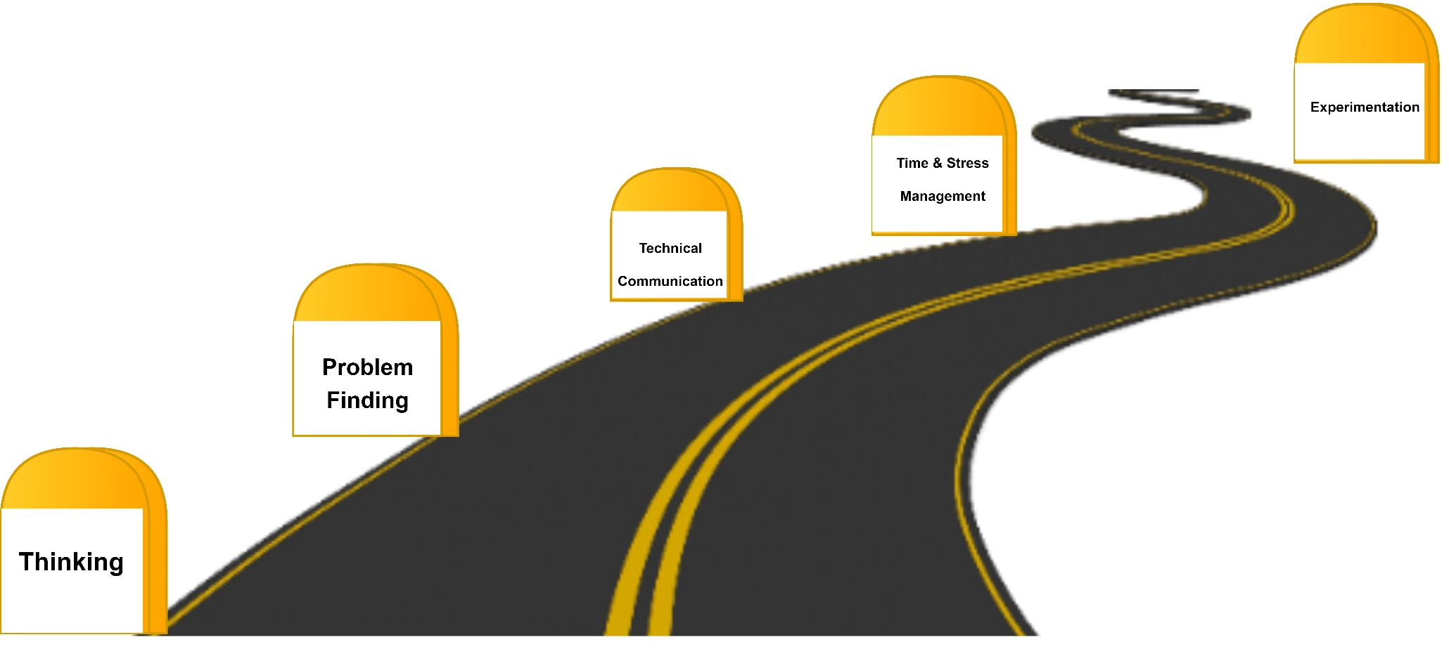
Research Skills
Department of Electronics and Communication Engineering, NIT Silchar
Kirti Swagat Mohanty
Scholar Id:21304068
kirti21_rs@ece.nits.ac.in

Slide 47
Writing Research Paper
Department of Electronics and Communication Engineering, NIT Silchar
Abstract
Clear and concise explaining bright idea
Introduction
Crucially important. Problem importance and related works’ pros and cons
Methodology and Design
A new design for addressing the problems pointed in Intro
Results
Usefulness of proposed design by evidencing by the achieved results
Conclusion
What has done in work and what can be done in future
References
Should follow single style through the article and list of references
“Short, Clear Title, Standard Format, Good writing style and Perfect referencing”.
Kirti Swagat Mohanty
Scholar Id:21304068
kirti21_rs@ece.nits.ac.in

Slide 48
Thesis Writing
Department of Electronics and Communication Engineering, NIT Silchar
Title
Abstract
Table of Contents
List of Figures & Tables
Introduction
Background theory
Design/theoretical analysis
Procedure
Results and discussion
Conclusions
References
Appendices
Abbreviations List
Kirti Swagat Mohanty
Scholar Id:21304068
kirti21_rs@ece.nits.ac.in

Slide 49
Course Outcome
Department of Electronics and Communication Engineering, NIT Silchar
Effective research procedure.
Qualitative and quantitative research analysis.
Framing of technical report and thesis
Conducive presentation skills.
Stress management and time management techniques to maintain a balance between social and professional life.
Kirti Swagat Mohanty
Scholar Id:21304068
kirti21_rs@ece.nits.ac.in

Slide 50
References
Department of Electronics and Communication Engineering, NIT Silchar
[1] R.Kumar,“Research methodology: A step-by-step guide for beginners,”Sage Publications Limited, 2019.
[2] E. M. Phillips, and D. S. Pugh,“How to get a Ph. D.-A Handbook for Ph. D. and Their Students,”McGraw-Hill Education, 4th ed., Maidenhead, England, 2005.
[3] A. Wilson,“Handbook of Science Communication,”,Taylor Fransic, 1st ed., Abingdon, UK, 1998.
Kirti Swagat Mohanty
Scholar Id:21304068
kirti21_rs@ece.nits.ac.in

Slide 51
Information Theory and Coding (EC 5135)
Department of Electronics and Communication Engineering, NIT Silchar
Course Instructors
Dr. Prabina Pattanayak, Dept. of ECE
Dr. Wasim Arif, Dept. of ECE
Kirti Swagat Mohanty
Scholar Id:21304068
kirti21_rs@ece.nits.ac.in

Slide 52
Contents
Department of Electronics and Communication Engineering, NIT Silchar
Information, Entropy, Mutual Information
Data Compression
Kraft Inequality
Shannon Coding Theorem
Channel Capacity of Different Channels
Motivation
Kirti Swagat Mohanty
Scholar Id:21304068
kirti21_rs@ece.nits.ac.in

Slide 53
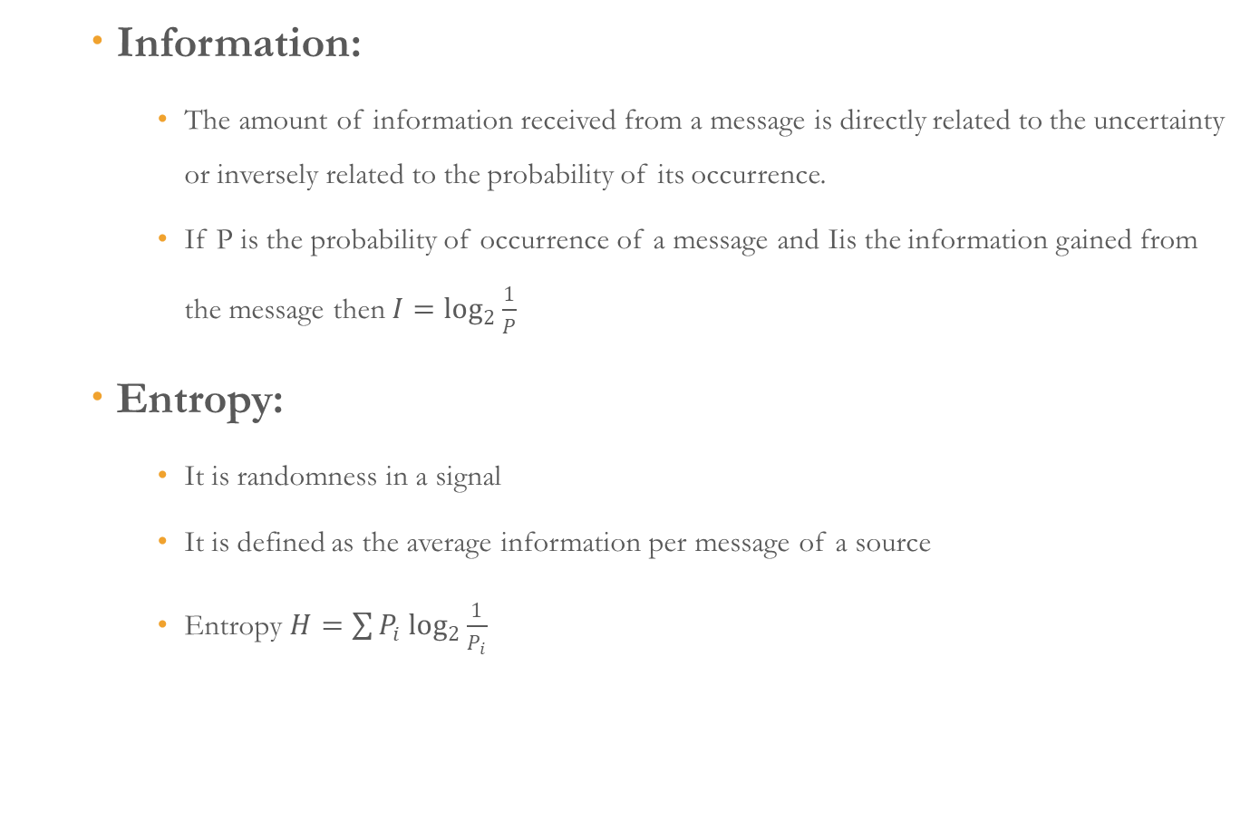
Information & Entropy
Department of Electronics and Communication Engineering, NIT Silchar
Information:
The amount of information received from a message is directly related to the uncertainty or inversely related to the probability of its occurrence.
If P is the probability of occurrence of a message and Iis the information gained from the message then $I=\log_{2}{\frac{1}{P}}$
Entropy:
It is randomness in a signal
It is defined as the average information per message of a source
Entropy $H=\sum{P_{i}\log_{2}{\frac{1}{P_{i}}}}$
Kirti Swagat Mohanty
Scholar Id:21304068
kirti21_rs@ece.nits.ac.in

Slide 54
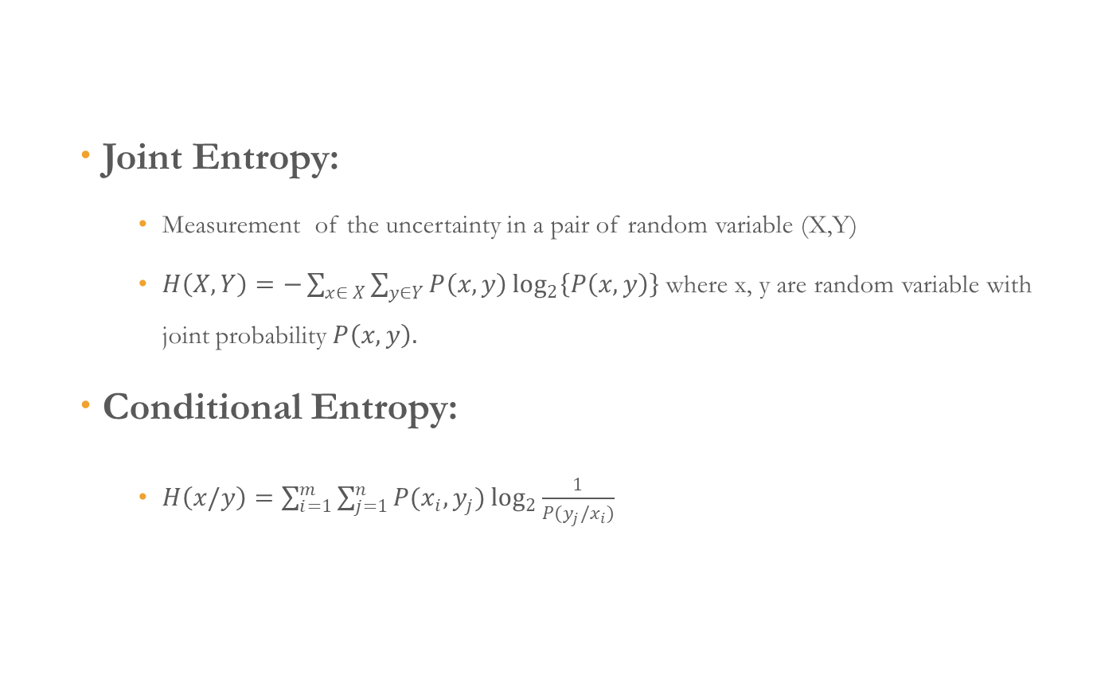
Joint Entropy & Conditional Entropy
Department of Electronics and Communication Engineering, NIT Silchar
Joint Entropy:
Measurement of the uncertainty in a pair of random variable (X,Y)
$H\left(X,Y\right)=−\sum_{x∈ X}{\sum_{y∈Y}{P\left(x,y\right)\log_{2}\left\{P\left(x,y\right)\right\}}}$where x, y are random variable with joint probability $P\left(x,y\right).$
Conditional Entropy:
$H\left(x/y\right)=\sum_{i=1}^{m}{\sum_{j=1}^{n}{P(x_{i},y_{j})\log_{2}{\frac{1}{P(y_{j}/x_{i})}} }}$
Kirti Swagat Mohanty
Scholar Id:21304068
kirti21_rs@ece.nits.ac.in

Slide 55
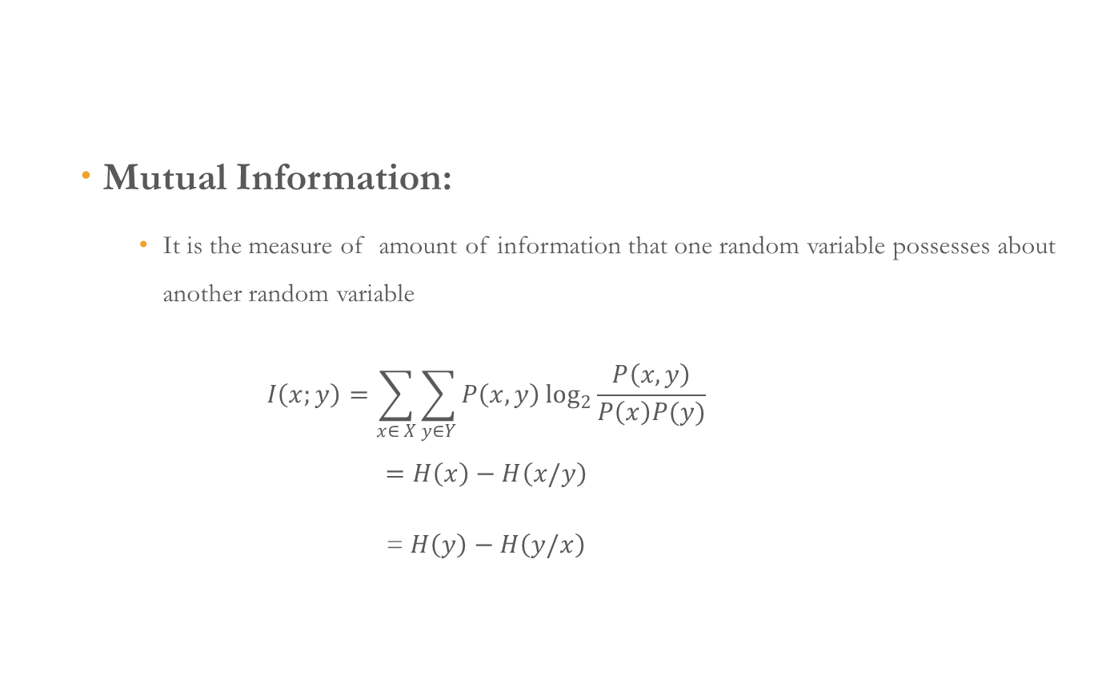
Mutual Information
Department of Electronics and Communication Engineering, NIT Silchar
Mutual Information:
It is the measure of amount of information that one random variable possesses about another random variable
$$I\left(x;y\right)=\sum_{x∈ X}{\sum_{y∈Y}{P\left(x,y\right)\log_{2}{\frac{P\left(x,y\right)}{P\left(x\right)P(y)}}}}$$
$$=H\left(x\right)−H\left(x/y\right)$$
= $H\left(y\right)−H\left(y/x\right)$
Kirti Swagat Mohanty
Scholar Id:21304068
kirti21_rs@ece.nits.ac.in

Slide 56
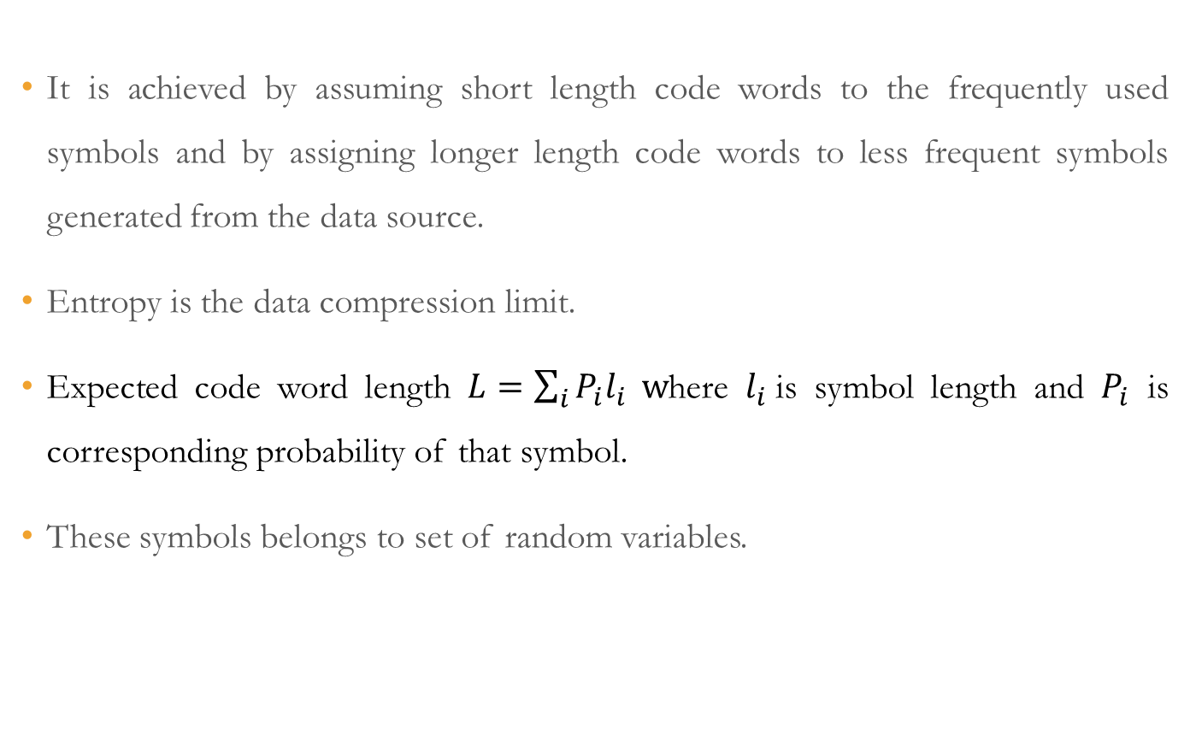
Data Compression
Department of Electronics and Communication Engineering, NIT Silchar
It is achieved by assuming short length code words to the frequently used symbols and by assigning longer length code words to less frequent symbols generated from the data source.
Entropy is the data compression limit.
Expected code word length $L=\sum_{i}{P_{i}l_{i}} w$here $l_{i}$is symbol length and $P_{i}$ is corresponding probability of that symbol.
These symbols belongs to set of random variables.
Kirti Swagat Mohanty
Scholar Id:21304068
kirti21_rs@ece.nits.ac.in

Slide 57
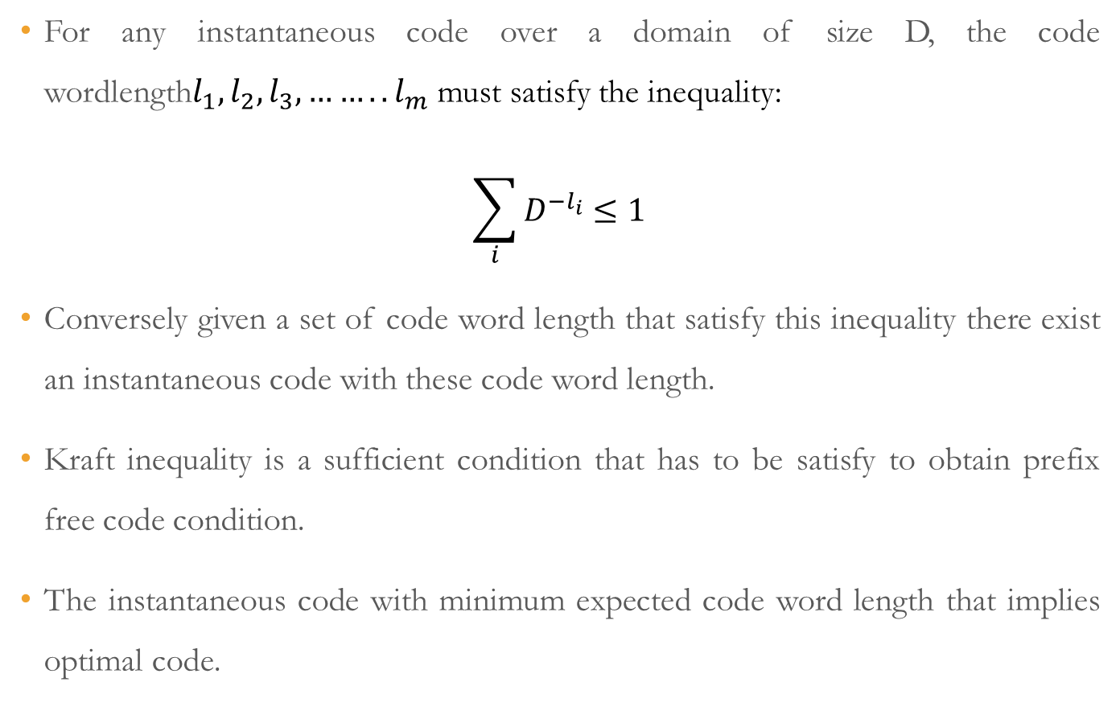
Kraft Inequality
Department of Electronics and Communication Engineering, NIT Silchar
For any instantaneous code over a domain of size D, the code wordlength$l_{1},l_{2},l_{3},……..l_{m}$ must satisfy the inequality:
$$\sum_{i}{D^{−l_{i}}≤1}$$
Conversely given a set of code word length that satisfy this inequality there exist an instantaneous code with these code word length.
Kraft inequality is a sufficient condition that has to be satisfy to obtain prefix free code condition.
The instantaneous code with minimum expected code word length that implies optimal code.
Kirti Swagat Mohanty
Scholar Id:21304068
kirti21_rs@ece.nits.ac.in

Slide 58
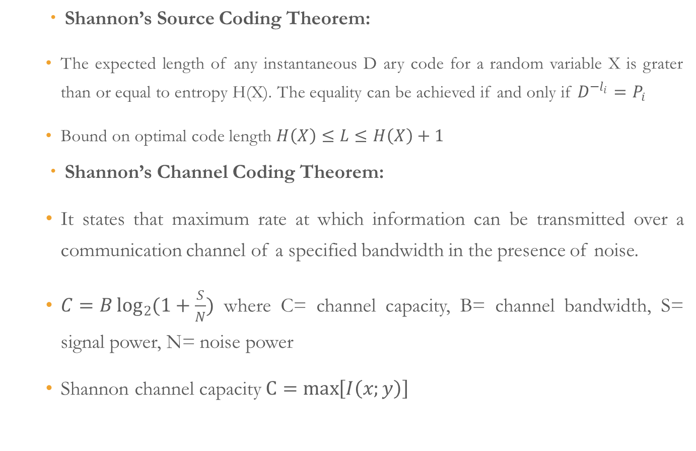
Shannon’s Coding Theorem
Department of Electronics and Communication Engineering, NIT Silchar
Shannon’s Source Coding Theorem:
The expected length of any instantaneous D ary code for a random variable X is grater than or equal to entropy H(X). The equality can be achieved if and only if $D^{−l_{i}}=P_{i}$
Bound on optimal code length $H\left(X\right)≤L≤H\left(X\right)+1$
Shannon’s Channel Coding Theorem:
It states that maximum rate at which information can be transmitted over a communication channel of a specified bandwidth in the presence of noise.
$C=B\log_{2}{(1+\frac{S}{N})}$ where C= channel capacity, B= channel bandwidth, S= signal power, N= noise power
Shannon channel capacity $C=\max\left[I\left(x;y\right)\right]$
Kirti Swagat Mohanty
Scholar Id:21304068
kirti21_rs@ece.nits.ac.in

Slide 59
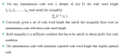
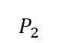

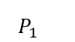
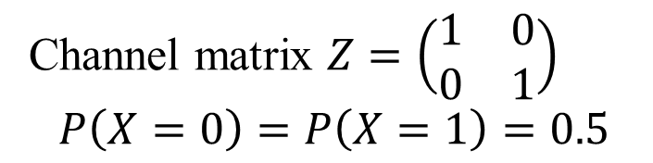
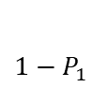
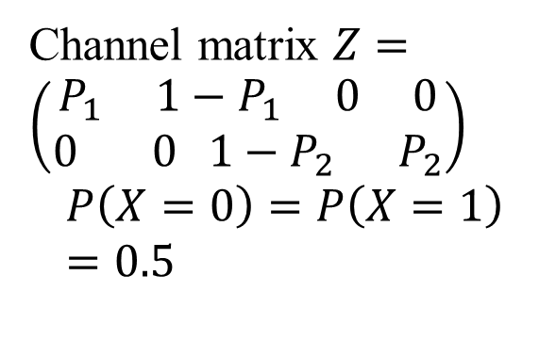
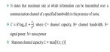
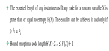
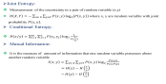
Different Channels
Department of Electronics and Communication Engineering, NIT Silchar
Noiseless Binary Channel:
Noisy Channel with Non Overlapping Outputs:
X
Y
Channel matrix $Z=\left(\begin{matrix}1 & 0 \\ 0 & 1\end{matrix}\right)$
$$P\left(X=0\right)=P\left(X=1\right)=0.5$$
0
0
1
1
Fig. 1. Noiseless binary channel
X
Y
Channel matrix $Z=\left(\begin{aligned}P_{1} 1−P_{1} 0 0 \\ 0 0 1−P_{2} P_{2}\end{aligned}\right)$
$$P\left(X=0\right)=P\left(X=1\right)=0.5$$
$$P_{1}$$
0
$${1−P}_{1}$$
$$y_{1}$$
$${1−P}_{2}$$
$$y_{2}$$
$$y_{3}$$
1
$$y_{4}$$
$$P_{2}$$
Fig. 2. Channel with overlapping outputs
Kirti Swagat Mohanty
Scholar Id:21304068
kirti21_rs@ece.nits.ac.in

Slide 60


Different Channels
Department of Electronics and Communication Engineering, NIT Silchar
Binary Symmetric Channel:
y
X
1-P
Channel matrix $Z=\left(\begin{matrix}1−P & P \\ P & 1−P\end{matrix}\right)$
$$P\left(X=0\right)=P\left(X=1\right)=0.5$$
0
P
0
P
1
1-P
1
Fig. 3. Binary Symmetric channel
Binary Erasure Channel:
X
1-α
y
0
0
Channel matrix $Z=\left(\begin{matrix}1−\text{α} & \text{α} & 0 \\ 0 & \text{α} & 1−\text{α}\end{matrix}\right)$
$$P\left(X=0\right)=a, P\left(X=1\right)=1−a$$
α
e
α
1
1
1- α
Fig. 4. Binary Erasure channel
Kirti Swagat Mohanty
Scholar Id:21304068
kirti21_rs@ece.nits.ac.in

Slide 61
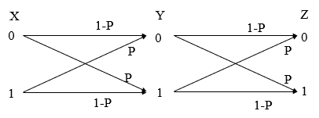
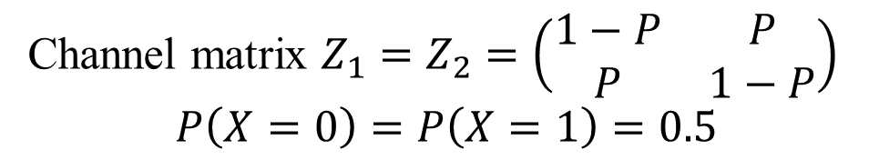
Different Channels
Department of Electronics and Communication Engineering, NIT Silchar
Cascading of Binary Symmetric Channel:
Fig. 5. Cascading of binary channel
Channel matrix $Z_{1}=Z_{2}=\left(\begin{matrix}1−P & P \\ P & 1−P\end{matrix}\right)$
$$P\left(X=0\right)=P\left(X=1\right)=0.5$$
Kirti Swagat Mohanty
Scholar Id:21304068
kirti21_rs@ece.nits.ac.in

Slide 62
Course Outcomes
Department of Electronics and Communication Engineering, NIT Silchar
Measuring information content of a message
Different source coding techniques for efficient transmission
Importance of channel capacity
Channel coding techniques to increase reliability of a system
Reference
[1] T. M Cover,J. A. Thomas,“Elements of information theory”, John Wiley & Sons, Inc Publication, Second Edition 2006.
[2] F. M. Reza,“An introduction to information theory”, Dover publication, Inc. New York Second Edition 1961.
[3] R. Bose, “ Information Theory, Coding and Cryptography ”,Tata Mcgraw Hill Publication, Second Edition 2008.
Kirti Swagat Mohanty
Scholar Id:21304068
kirti21_rs@ece.nits.ac.in

Slide 63
References
Department of Electronics and Communication Engineering, NIT Silchar
[1] T. M Cover,J. A. Thomas,“Elements of information theory”, John Wiley & Sons, Inc Publication, Second Edition 2006.
[2] F. M. Reza,“An introduction to information theory”, Dover publication, Inc. New York Second Edition 1961.
[3] R. Bose, “ Information Theory, Coding and Cryptography ”,Tata Mcgraw Hill Publication, Second Edition 2008.
Kirti Swagat Mohanty
Scholar Id:21304068
kirti21_rs@ece.nits.ac.in

Slide 64
Image Processing (EC- 5141)
Department of Electronics and Communication Engineering, NIT Silchar
Course Instructors
Dr. Ram Kumar Karsh, Dept. of ECE
Kirti Swagat Mohanty
Scholar Id:21304068
kirti21_rs@ece.nits.ac.in

Slide 65
Content
Department of Electronics and Communication Engineering, NIT Silchar
Image Fundamentals
Image Enhancement
Image Restoration
Kirti Swagat Mohanty
Scholar Id:21304068
kirti21_rs@ece.nits.ac.in

Slide 66

Stages in Image Processing
Image Restoration
Morphological Processing
Image Enhancement
Segmentation
Image Acquisition
Object Recognition
Representation & Description
Problem Domain
Colour Image Processing
Image Compression

Slide 67
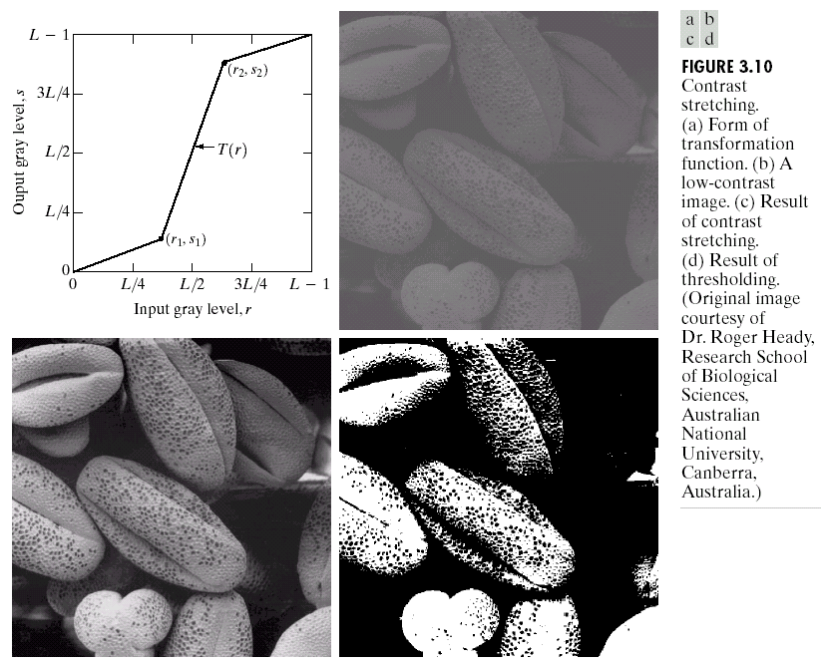
Stages in Image Processing
Image Restoration
Morphological Processing
Image Enhancement
Segmentation
Image Acquisition
Object Recognition
Representation & Description
Problem Domain
Colour Image Processing
Image Compression

Slide 68
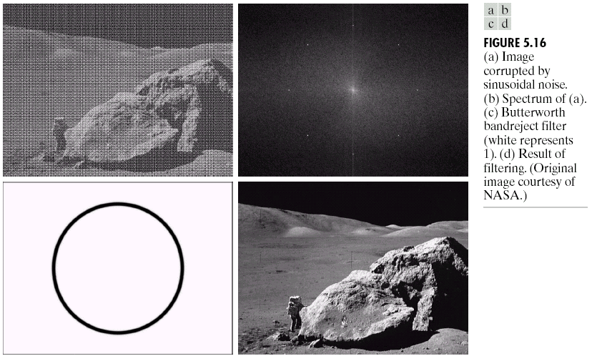
Stages in Image Processing
Image Restoration
Morphological Processing
Image Enhancement
Segmentation
Image Acquisition
Object Recognition
Representation & Description
Problem Domain
Colour Image Processing
Image Compression

Slide 69
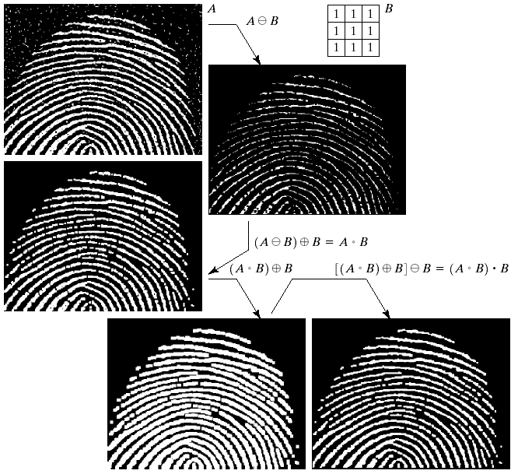
Stages in Image Processing
Image Restoration
Morphological Processing
Image Enhancement
Segmentation
Image Acquisition
Object Recognition
Representation & Description
Problem Domain
Colour Image Processing
Image Compression

Slide 70
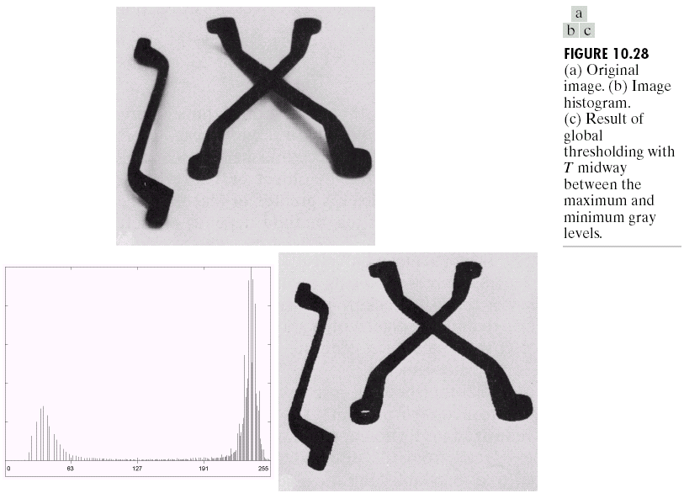
Stages in Image Processing
Image Restoration
Morphological Processing
Image Enhancement
Segmentation
Image Acquisition
Object Recognition
Representation & Description
Problem Domain
Colour Image Processing
Image Compression

Slide 71
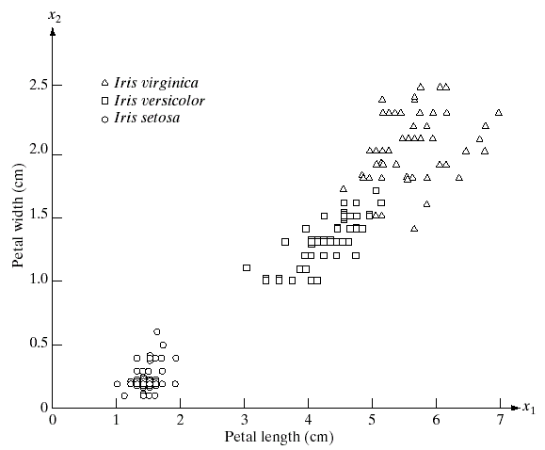
Stages in Image Processing
Image Restoration
Morphological Processing
Image Enhancement
Segmentation
Image Acquisition
Object Recognition
Representation & Description
Problem Domain
Colour Image Processing
Image Compression

Slide 72
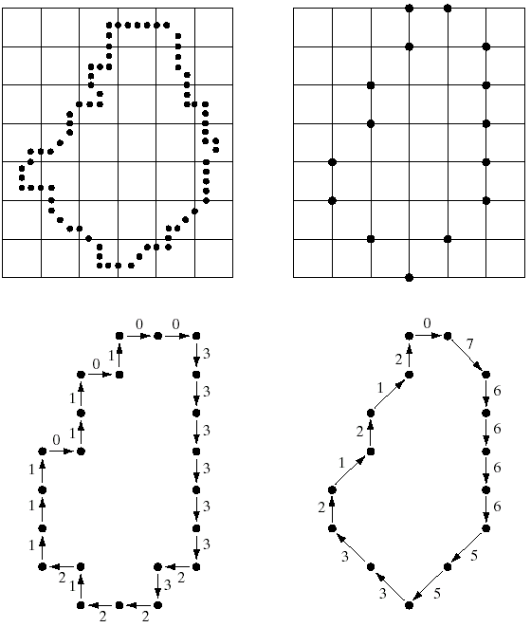
Stages in Image Processing
Image Restoration
Morphological Processing
Image Enhancement
Segmentation
Image Acquisition
Object Recognition
Representation & Description
Problem Domain
Colour Image Processing
Image Compression

Slide 73
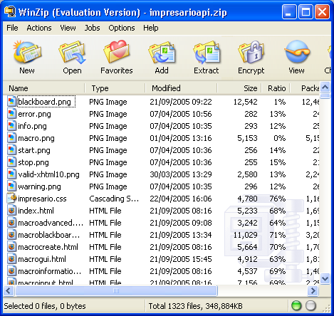
Stages in Image Processing
Image Restoration
Morphological Processing
Image Enhancement
Segmentation
Image Acquisition
Object Recognition
Representation & Description
Problem Domain
Colour Image Processing
Image Compression

Slide 74
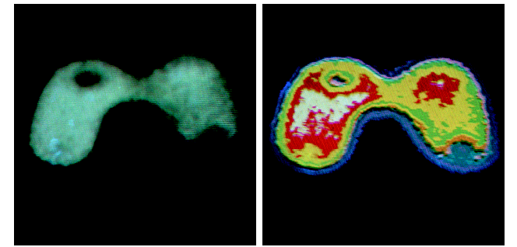
Stages in Image Processing
Image Restoration
Morphological Processing
Image Enhancement
Segmentation
Image Acquisition
Object Recognition
Representation & Description
Problem Domain
Colour Image Processing
Image Compression

Slide 75
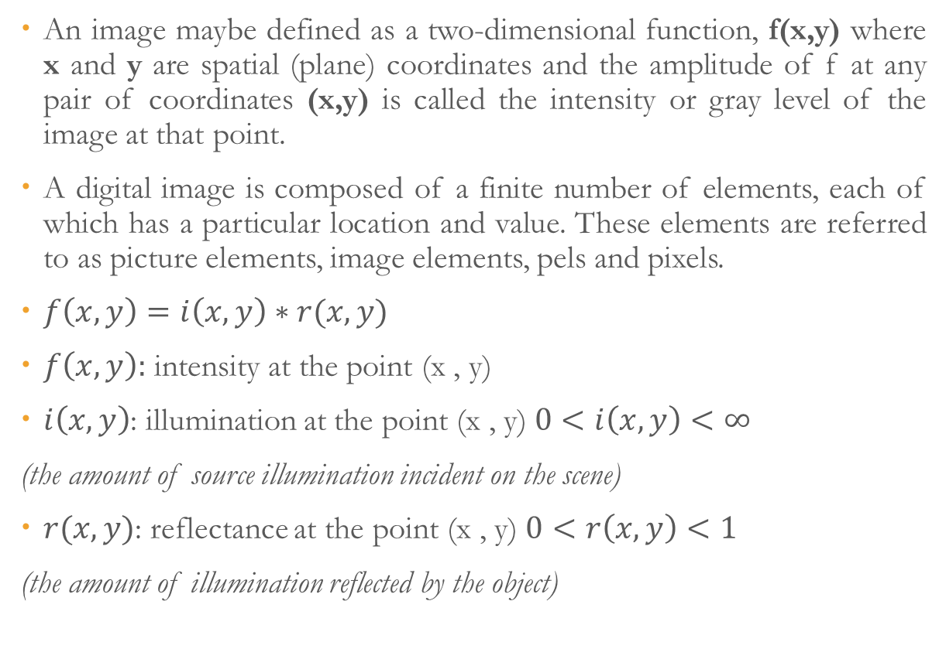
Image Fundamentals
Department of Electronics and Communication Engineering, NIT Silchar
An image maybe defined as a two-dimensional function, f(x,y) where x and y are spatial (plane) coordinates and the amplitude of f at any pair of coordinates (x,y) is called the intensity or gray level of the image at that point.
A digital image is composed of a finite number of elements, each of which has a particular location and value. These elements are referred to as picture elements, image elements, pels and pixels.
$f\left(x,y\right)=i\left(x,y\right)∗r(x,y)$
$f\left(x,y\right):$ intensity at the point (x , y)
$i\left(x,y\right)$: illumination at the point (x , y) $0<i\left(x,y\right)<∞$
(the amount of source illumination incident on the scene)
$r(x,y)$: reflectance at the point (x , y) $0<r\left(x,y\right)<1$
(the amount of illumination reflected by the object)
Kirti Swagat Mohanty
Scholar Id:21304068
kirti21_rs@ece.nits.ac.in

Slide 76
Purpose of Image Processing
Department of Electronics and Communication Engineering, NIT Silchar
The main purpose of the Image Processing are divided into following groups:
Visualization: The objects which are not visible, they are observed.
Image Sharpening and restoration: It is used for better image resolution.
Image Retrieval: An image of interest can be seen
Measurement of Pattern: In an image, all the objects are measured
Image Recognition: Each object in an image an be distinguished
Kirti Swagat Mohanty
Scholar Id:21304068
kirti21_rs@ece.nits.ac.in

Slide 77
Fundamental Steps of Image Processing
Department of Electronics and Communication Engineering, NIT Silchar
Image Acquisition: In this stage an image is given in the digital form. Generally in this stage, pre-processing such as scaling is done.
Image Enhancement: In this stage details which are not known or we can say that interesting features of an image is highlighted. Such as Brightness, Contrast etc.
Image Restoration: Image Restoration is the stage in which the appearance of an image is improved.
Color Image Processing: In this stage color modelling, processing in a digital domain takes place.
Wavelets and Multi-Resolution Processing: In this stage, an image is represented in various degrees of resolutions. Image is divided into smaller regions for data compression and for the pyramidal representation.
Kirti Swagat Mohanty
Scholar Id:21304068
kirti21_rs@ece.nits.ac.in

Slide 78
Fundamental Steps of Image Processing
Department of Electronics and Communication Engineering, NIT Silchar
Compression: It is a technique which is used for reducing the requirement of storing an image. It is very necessary to compress data for internet use.
Morphological Processing: This stage deals with tools which are used for extracting the components of the image, which is useful in the representation and description of shape.
Segmentation: In this stage, an image is partitioned into its objects. Segmentation is the most difficult task. It is the process which takes a lot of time for successful solution of imaging problems which requires objects to identify individually.
Representation and Description: It follows the output of the segmentation stage. The output is a raw pixel data which has all points of the region itself. To transform the raw data, representation is the only solution, whereas description is used for extracting information to differentiate one class of objects from another.
Object Recognition: In this stage, the label is assigned to the object, which is based on descriptors.
Kirti Swagat Mohanty
Scholar Id:21304068
kirti21_rs@ece.nits.ac.in

Slide 79
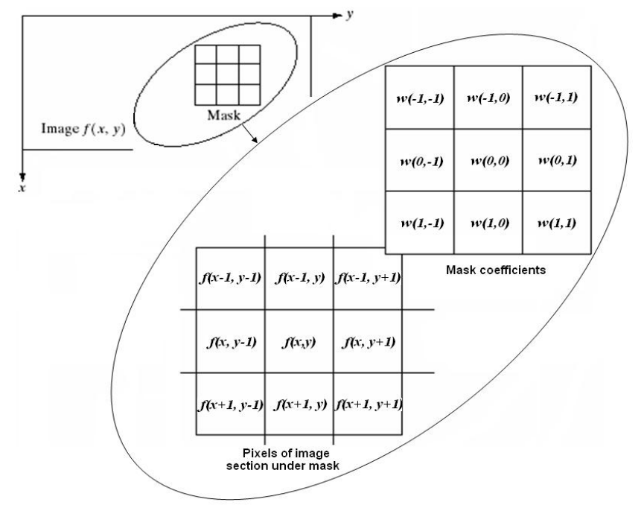
Spatial Domain Filtering
Department of Electronics and Communication Engineering, NIT Silchar
It refers to image operators that change the gray value at any pixel (x,y) depending on the pixel values in a square neighborhood centered at (x,y) using a fixed integer matrix of the same size.
The integer matrix is called a filter, mask, kernel or window.
Kirti Swagat Mohanty
Scholar Id:21304068
kirti21_rs@ece.nits.ac.in
Notes:
The mechanism of spatial filtering, shown above consist simply of moving the filter mask from pixel to pixel in an image.
At each pixel (x,y) the response of the filter at that pixel is calculated using a predefined relationship (linear or non-linear)
The size of he mask must be odd i.e. 3x3, 5x5 etc to ensure it has a center . The smallest meaningful size is 3x3

Slide 80
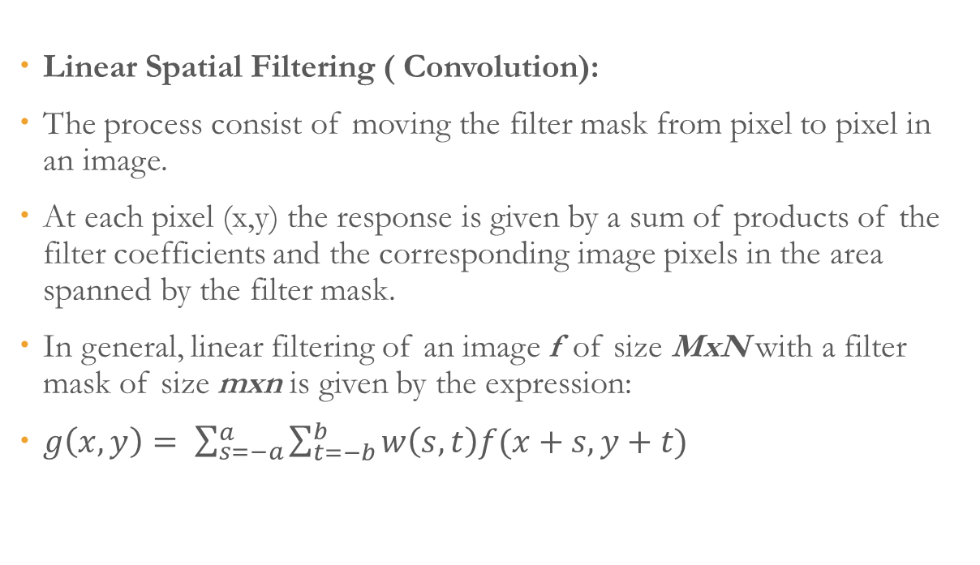
Classification
Department of Electronics and Communication Engineering, NIT Silchar
There are two types on the basis of linearity:
1. Linear Spatial Filter
Non-linear Spatial Filter
Linear Spatial Filtering ( Convolution):
The process consist of moving the filter mask from pixel to pixel in an image.
At each pixel (x,y) the response is given by a sum of products of the filter coefficients and the corresponding image pixels in the area spanned by the filter mask.
In general, linear filtering of an image f of size MxN with a filter mask of size mxn is given by the expression:
$g\left(x,y\right)= \sum_{s=−a}^{a}{\sum_{t=−b}^{b}{w\left(s,t\right)f(x+s,y+t)}}$
Kirti Swagat Mohanty
Scholar Id:21304068
kirti21_rs@ece.nits.ac.in
Notes:
Where a= (m-1)/2 and b= (n-1)/2.
To generate a complete filtered image this equation must be applied for x= 0,1,2, … M-1 and y=0,1,2…,N-1

Slide 81
Nonlinear Spatial Filtering
Department of Electronics and Communication Engineering, NIT Silchar
The operation also consist of moving the filter mask from pixel to pixel in an image.
The filtering operation is based conditionally on the values of the pixels in the neighborhood, and they do not explicitly use coefficients in the sum-of-products manner.
E:g. Noise reduction can be achieved effectively with a nonlinear filter whose basic function is to compute the median gray-level value in the neighborhood in which the filter is located. Computation of the median is a nonlinear operation.
Kirti Swagat Mohanty
Scholar Id:21304068
kirti21_rs@ece.nits.ac.in

Slide 82
Spatial Filters
Department of Electronics and Communication Engineering, NIT Silchar
Spatial filters can be classified by effect into:
Smoothing Spatial Filters: also called lowpass filters. They include:
Averaging linear filters
Order-statistics nonlinear filters
Sharpening Spatial Filters: also called highpass filters. For example, the Laplacian linear filter.
Kirti Swagat Mohanty
Scholar Id:21304068
kirti21_rs@ece.nits.ac.in

Slide 83
Spatial Filters
Department of Electronics and Communication Engineering, NIT Silchar
Smoothing Spatial Filters:
They are used for blurring and for noise reduction. Blurring is used in preprocessing steps to:
Remove small details from an image prior to (large) object extraction.
Bridge small gaps in lines or curves.
Noise reduction can be accomplished by blurring with a linear filter and also by nonlinear filtering.
Averaging linear filters:
The response of averaging filter is simply the average of the pixels contained in the neighborhood of the filter mask.
The output of averaging filters is a smoothed image with reduced “sharp” transitions in gray levels.
Noise and edges consist of sharp transitions in gray levels.
Thus smoothing filters are used for noise reduction, however they have the undesirable side effect that they blur edges.
Kirti Swagat Mohanty
Scholar Id:21304068
kirti21_rs@ece.nits.ac.in

Slide 84
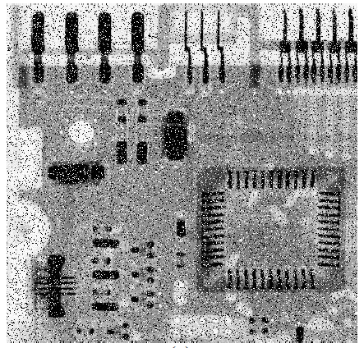
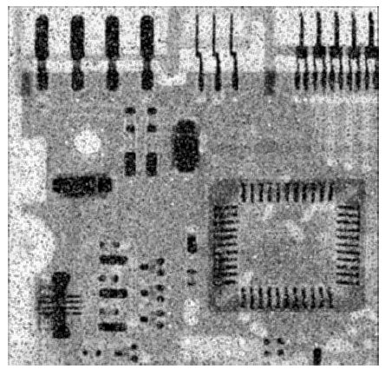
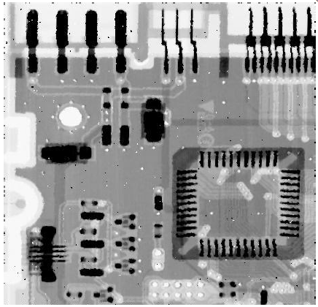
Order-statistics filters
Department of Electronics and Communication Engineering, NIT Silchar
They are nonlinear spatial filters whose response is based on ordering (ranking) the pixels contained in the neighborhood, and then replacing the value of the centre pixel with the value determined by the ranking reslt.
E:g: Median Filter, Max Filter Min filters
Image corrupted by Salt and Pepper noise
Result of Average Filter
Result of Median Filter
Kirti Swagat Mohanty
Scholar Id:21304068
kirti21_rs@ece.nits.ac.in

Slide 85


Image Restoration
Department of Electronics and Communication Engineering, NIT Silchar
The purpose of Restoration is to “compensate for” or “undo” defects which degrade an image
Degrade Causes
Camera: translation, shake, out-of-focus etc.
Environment: scattered and reflected light
Device noise: sensor and circuitry
Quantization noise
Ideal Image
Blurred Image
Kirti Swagat Mohanty
Scholar Id:21304068
kirti21_rs@ece.nits.ac.in

Slide 86
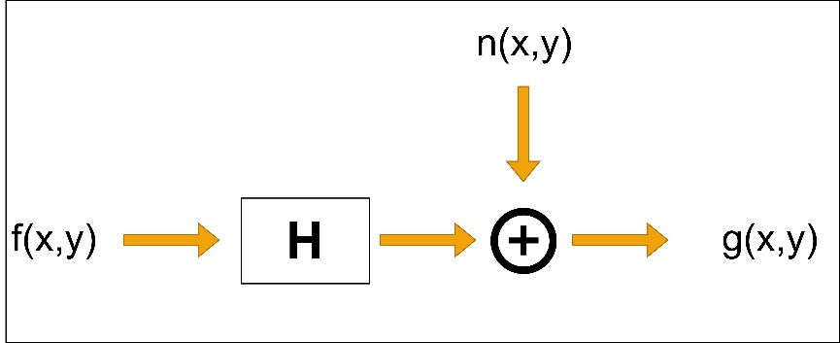
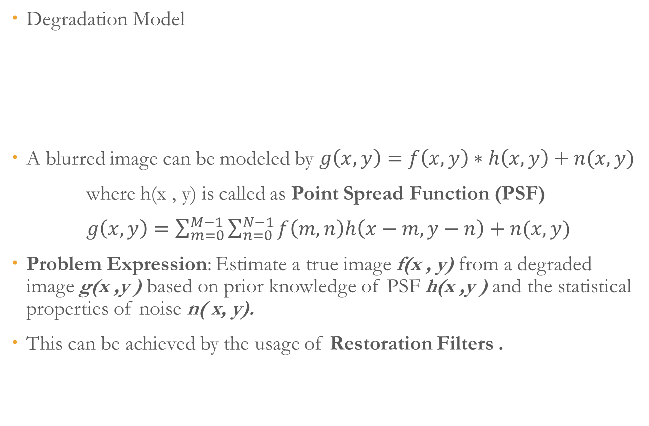
Image Restoration
Department of Electronics and Communication Engineering, NIT Silchar
Degradation Model
A blurred image can be modeled by $g\left(x,y\right)=f\left(x,y\right)∗h\left(x,y\right)+n(x,y)$
where h(x , y) is called as Point Spread Function (PSF)
$g\left(x,y\right)=\sum_{m=0}^{M−1}{\sum_{n=0}^{N−1}{f\left(m,n\right)h\left(x−m, y−n\right)+n(x,y)}}$
Problem Expression: Estimate a true image f(x , y) from a degraded image g(x ,y ) based on prior knowledge of PSF h(x ,y ) and the statistical properties of noise n( x, y).
This can be achieved by the usage of Restoration Filters .
Kirti Swagat Mohanty
Scholar Id:21304068
kirti21_rs@ece.nits.ac.in

Slide 87
Restoration Filters
Department of Electronics and Communication Engineering, NIT Silchar
There are following types of filters:
Inverse Filter
Pseudo Inverse Filter
Wiener Filter
Inverse Filter:
It is the process of receiving the input of a system from its output.
It is the simplest approach to restore the original image once the degradation function is known.
Pseudo Inverse Filter:
It is the modified version of the inverse filter and stabilized inverse filter.
It gives more better result than inverse filtering but inverse and pseudo inverse are sensitive to noise.
Wiener Filter:
It executes and optimal trade off between filtering and noise smoothing.
It tries to minimize the mean square error between uncorrupted image and estimated image.
Kirti Swagat Mohanty
Scholar Id:21304068
kirti21_rs@ece.nits.ac.in

Slide 88

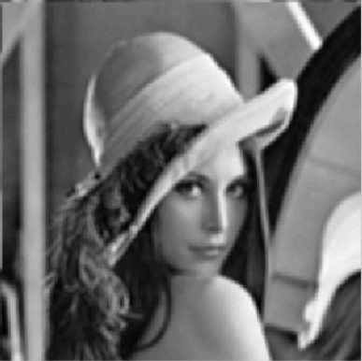
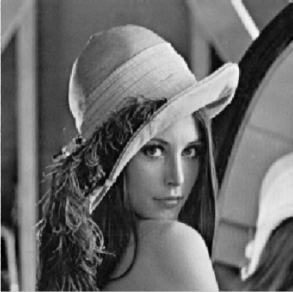
Image Restoration
Department of Electronics and Communication Engineering, NIT Silchar
Original Image
Blurred Image
Restored Image using Inverse Filtering
Kirti Swagat Mohanty
Scholar Id:21304068
kirti21_rs@ece.nits.ac.in

Slide 89
References
Department of Electronics and Communication Engineering, NIT Silchar
Gonzalez, R. C. and Woods, R. E., "Digital Image Processing", Prentice Hall, 3rd Ed.
Jain, A. K., "Fundamentals of Digital Image Processing", PHI Learning, 1st Ed.
Kirti Swagat Mohanty
Scholar Id:21304068
kirti21_rs@ece.nits.ac.in

Slide 90



Thank You
Department of Electronics and Communication Engineering, NIT Silchar
kirtiswagat@gmail.com
https://www.linkedin.com/in/kirtiswagatmohanty/
@kirtiswagat
Kirti Swagat Mohanty
Scholar Id:21304068
kirti21_rs@ece.nits.ac.in

